Slide 1
A FACE RECOGNITION SYSTEM
ZEROTH REVIEW
Guided By,
Mr.M.Vignesh,
Assistant Professor,
Department of Artificial Intelligence and Data Science,
Karpagam Institute of Technology,
Coimbatore.
Presented by
S.DHANUSH(721220243010)
V.KISHOR KUMAR(721220243027)
S.LINKEDH (721220243028)
S.VIMAL(721220243062)
Department of Artificial Intelligence and Data Science,
Karpagam Institute of Technology,
Coimbatore.

Slide 2
Introduction (A FACE RECOGNITION SYSTEM)
Facial recognition uses Computer-generated filters to transform face images into numerical expressions that can be compared to determine their similarity.
Human face recognition systems use unique mathematical patterns to store biometric data.
Face recognition is a type of computer vision that uses optical input to analyse an image—in this case, it looks particularly at faces that appear in the image.

Slide 3
Problem Identification
DETECTION RATE
The Lowest detectable quantity of analyte that can be distinguished from the absence of the analyte
TRANING TIME
Very slow Training and Processing time
REDUNDANCY IN FACE DETECTION
The Redundancy in the Face Detection should reduced to get more accurate outcomes

Slide 4
Literature Survey
A FACE RECOGNITION SYSTEM
Kartika Candra Kirana, Slamet Wibawanto, Heru Wahyu Herwanto ,
"Redundancy Reduction in Face Detection of Viola & Jones using the Hill Climbing Algorithm",
The Viola Jones algorithm applied the Haar Wavelet, which is calculated by applying the pixel strength. Haar-like features are used for the feature extraction thus getting an Integral image. Ada Boost and Cascade classifier are also Used.
D.Shamia, D.Abraham Chandy,
"Analyzing the Performance of Viola Jones Face Detector on the LDHF Database"
By using these techniques the efficiency and the accuracy got better but the time taken to detect the face lurks.

Slide 5
Literature Survey
A FACE RECOGNITION SYSTEM
Mangayarkarasi Nehru, Dr. Padmavathi S,
"Illumination Invariant Face Detection Using Viola Jones Algorithm"
We consider certain constraints and check if the faces are detected for all the different datasets and meet the conditions.

Slide 6
Proposed Work
The combination of Single Shot Detection and Viola – Jones algorithm to efficiently detect various parts of the human faces.
SSD is significantly faster in speed and high-accuracy object detection algorithm.
There are Three Basic methods used by Viola-Jones method which is as follows:
Haar-like features
Ada Boost
Cascade classifier

Slide 7
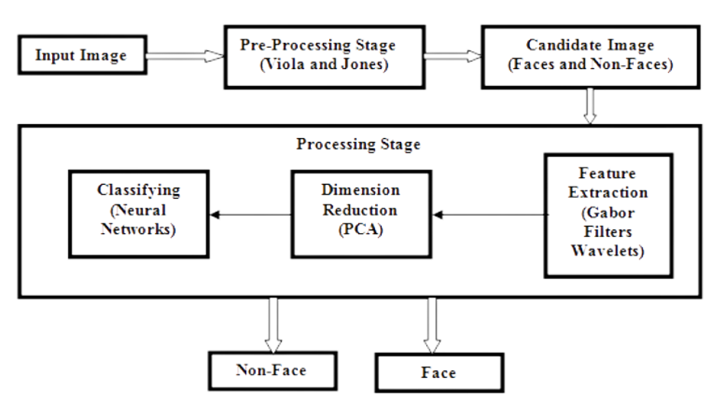
System Architecture

Slide 8
Algorithm implemented
VIOLA JONES ALGORITHM
It is the one of the oldest algorithm for object detection
Inspite of it was old it has a high accuracy and speed detection
It uses haar like features to detect by detecting the features like nose mouth etc..
It also uses Adaboost & Haar Cascade Classifier
SINGLE SHOT DETECTOR
Prediction for the bounding boxes and confidence for different objects in the image is done not by one but by multiple feature maps of different sizes that represent multiple scales.
It takes only one shot to detect multiple objects present in an image using multibox

Slide 9
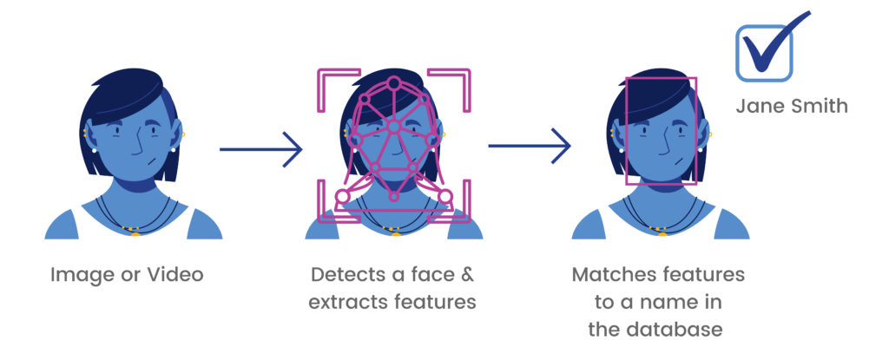
Expected Deliverables
High Detection rate
Low Training Time
Improved Accuracy
Optimized to Consume Low Memory and Response Time
Accurate Detection and Recognition of the Person

Slide 10
References
Mangayarkarasi Nehru, Dr. Padmavathi S.
ILLUMINATION INVARIANT FACE DETECTION USING VIOLA JONES ALGORITHM
International Conference on Advanced Computing and Communication Systems (ICACCS -2017), Jan. 06 – 07, 2017
Kartika Candra Kirana, Slamet Wibawanto , Heru Wahyu Herwanto
REDUNDANCY REDUCTION IN FACE DETECTION OF VIOLA & JONES USING THE HILL CLIMBING ALGORITHM
2020 THE 4TH INTERNATIONAL CONFERENCE ON VOCATIONAL EDUCATION AND TRAINING
D.Shamia, D.Abraham Chandy
ANALYZING THE PERFORMANCE OF VIOLA JONES FACE DETECTOR ON THE LDHF DATABASE
International Conference on Signal Processing and Communication (ICSPC’17) – 28th & 29th July 2017
Mohammad Da'san, Amin Alqudah and Olivier Debeir
FACE DETECTION USING VIOLA AND JONES METHOD AND NEURAL NETWORKS
2015 International Conference on Information and Communication Technology Research (ICTRC2015)
HTTPS://TOWARDSDATASCIENCE.COM/SSD-SINGLE-SHOT-DETECTOR-FOR-OBJECT-DETECTION-USING-MULTIBOX-1818603644CA

Slide 11
Thank You!

